Slide 1
Project MobileNet_VC709
Weekly Progress
IBM Research AI
Zhao Zhongyu, Chen Jiabao
13/09/21 @ University of Macau

Slide 2
Outline
Quantization Problem Solved
Problems found in Simulation
A New Structure Design
Next Phase

Slide 3
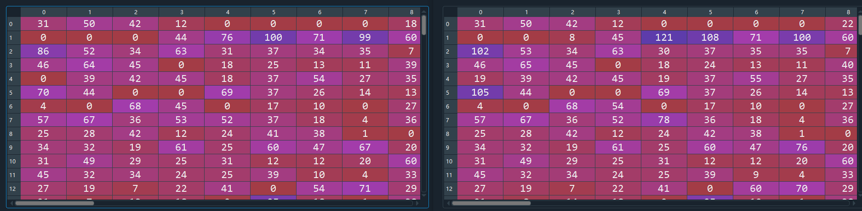
Quantization Problem Solved
At first, we didn't know what to do with the input normalized image before the first layer convolution to find the input scale and input zeropoint.
After checking the underlying code, we find that a MinMaxObserver is used to find the scale and zeropoint.
We call MinMaxObserver to process the input image, and about 8% of the calculated results are different from the model of Pytorch.
First layer output of Pytorch (left) and our model (right)

Slide 4
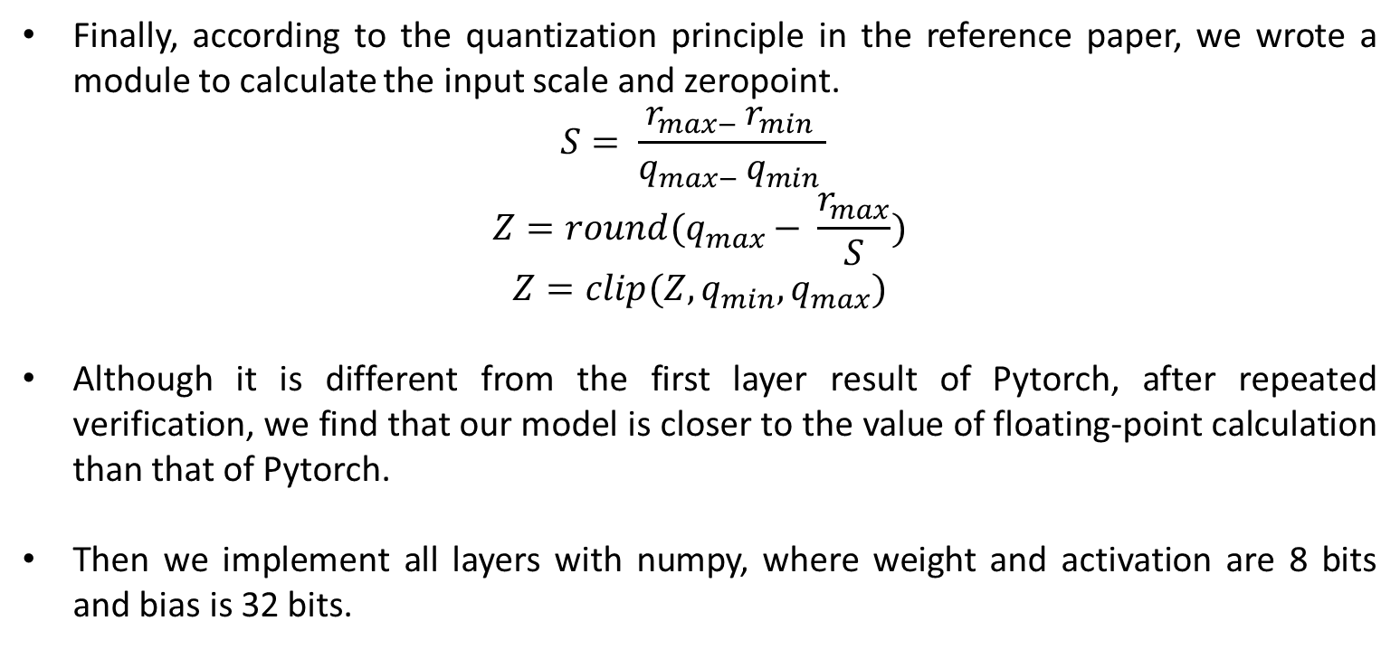
Quantization Problem Solved
Finally, according to the quantization principle in the reference paper, we wrote a module to calculate the input scale and zeropoint.
$$S= \frac{r_{max− }r_{min }}{q_{max− }q_{min }}$$
$$Z=round(q_{max}− \frac{r_{max}}{S})$$
$$Z=clip(Z,q_{min}, q_{max})$$
Although it is different from the first layer result of Pytorch, after repeated verification, we find that our model is closer to the value of floating-point calculation than that of Pytorch.
Then we implement all layers with numpy, where weight and activation are 8 bits and bias is 32 bits.

Slide 5
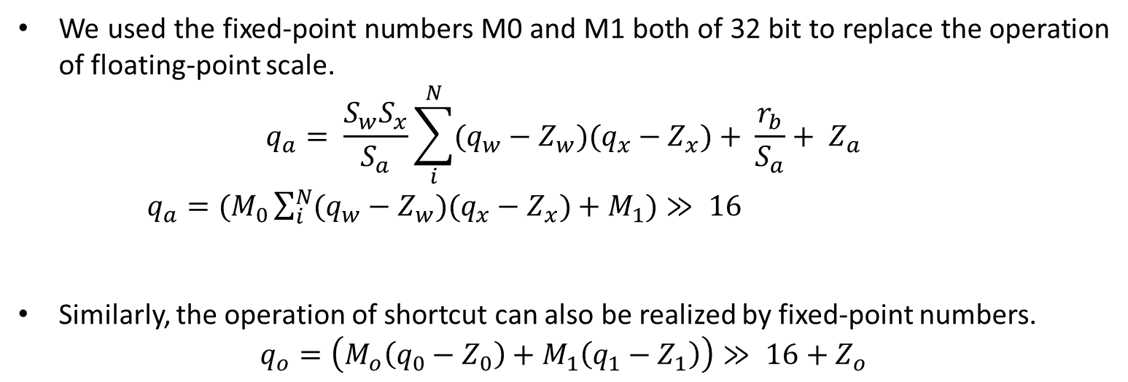
Quantization Problem Solved
We used the fixed-point numbers M0 and M1 both of 32 bit to replace the operation of floating-point scale.
$$q_{a}= \frac{S_{w}S_{x}}{S_{a}}\sum_{i}^{N}{(q_{w}−Z_{w})(q_{x}−Z_{x})}+ \frac{r_{b}}{S_{a}}+ Z_{a}$$
$q_{a}=(M_{0}\sum_{i}^{N}{(q_{w}−Z_{w})(q_{x}−Z_{x})}+M_{1})≫ 16$
Similarly, the operation of shortcut can also be realized by fixed-point numbers.
$$q_{o}=\left(M_{o}\left(q_{0}−Z_{0}\right)+M_{1}\left(q_{1}−Z_{1}\right)\right)≫ 16+Z_{o}$$

Slide 6
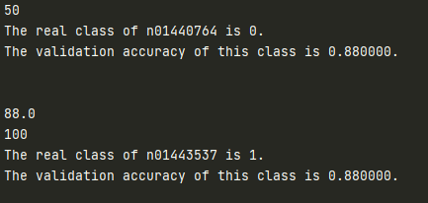
Quantization Problem Solved
Since an image needs more than ten minutes to be recognized, we tested about 100 pictures in one day, and the recognition accuracy is slightly higher than that of the floating-point model.
Test result of 100 images

Slide 7
Outline
Quantization Problem Solved
Problems found in Simulation
A New Structure Design
Next Phase

Slide 8
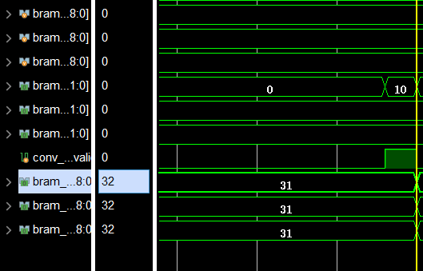
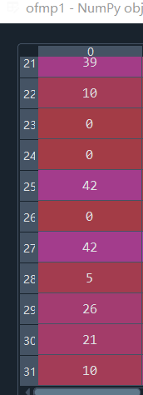
The Result was Verified
All the inference process have been verified, and after debugging, the output can be correctly derived.
The verification result of the first layer output
Notes:
What if the limit is too large? – missing difference b/t small samples
What if the limit is too small? – directly missing the large samles

Slide 9
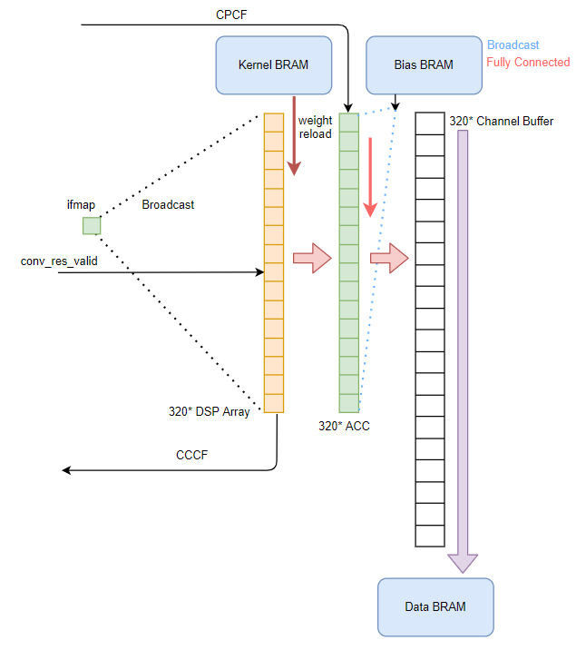
Pipeline Stall Problem
Performance is low: simulation shows the inference time is high up to 1784ms when operating under 100Hz clock rate.
Reason:
1. When processing PW convolution, to ensure the high DSP utilization rate, the Kernel BRAM have to possess a high band width of 320bytes, eliminating any potentials of implementing ifmap channel parallelism.
2. In order to protect the storage pattern of the next layer’s ifmap(which is the ofmap of this PW layer), the ofmap channels have to be written one by one into our BRAM, at the same time, the previous pipeline has to be stalled, which also eliminating the advantage of ofmap channel parallelism.
PW module architecture of previous design
Notes:
What if the limit is too large? – missing difference b/t small samples
What if the limit is too small? – directly missing the large samles

Slide 10
Outline
Quantization Problem Solved
Problems found in Simulation
A New Structure Design
Next Phase

Slide 11
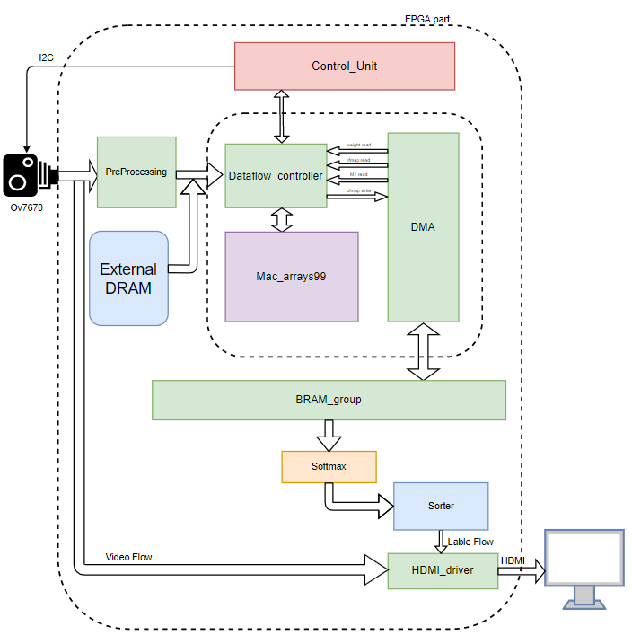
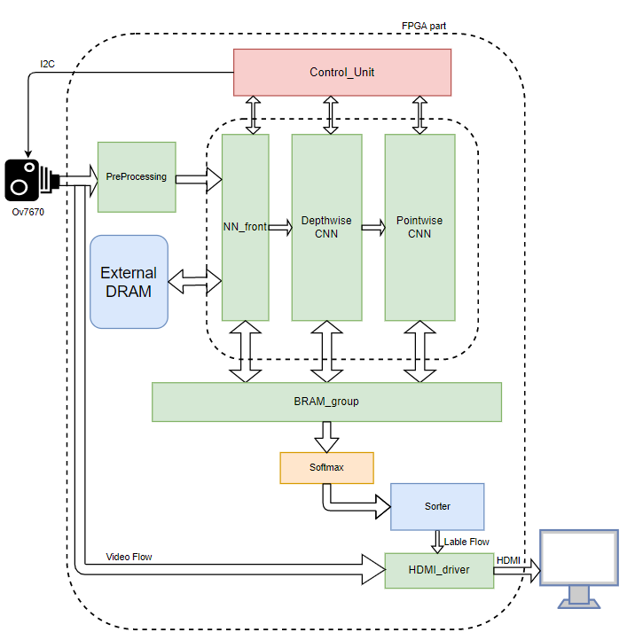
New Structure Design vs. the Old One
The updated system structure
The old design version

Slide 12
Ifmap output pattern
81 ifmap values which was composed by 9 channels of a 3*3 window output from the Brams per clk.
Every 9 channels of a feature map pixel are concatenated together to occupy a depth unit of the BRAM. While we are using 9 BRAM module to give and take feature map values, it means that the input band width is 9*9 = 81, and the output band width are 9 because we are expecting 9 channels of an ofmap pixel are evaluated from those 81 input pixels at a time.
Based on the mode configuration of the Data Flow Controller module, the input 81 pixels can be Rearranged, Broadcasted, Concatenated or Converted to the value of input zero point before begin sent into the 9*9 MAC Array.
Notes:
Alpha will appear in loss fun, and taking derivative of it can lead to its optimal value

Slide 13
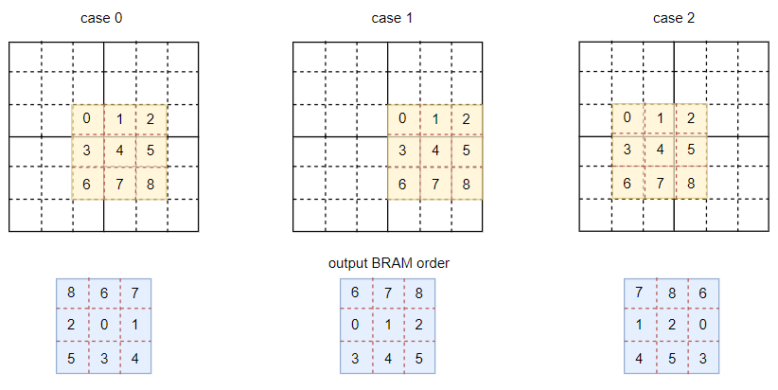
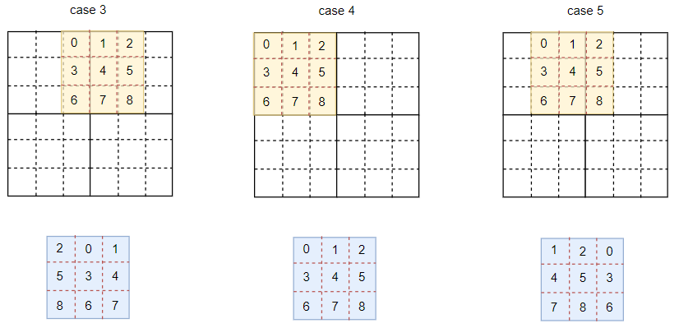
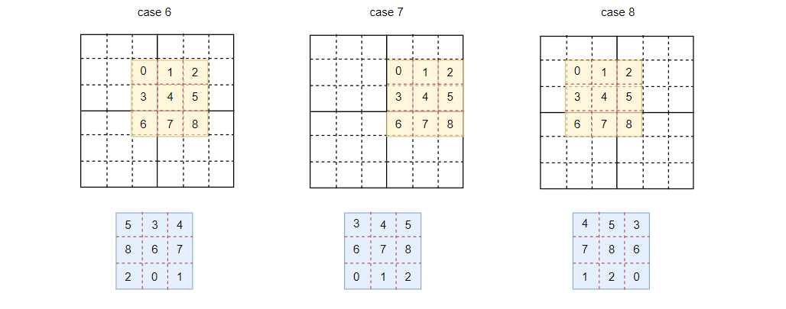
Ifmap output pattern
The output pattern of ifmap
Notes:
Alpha will appear in loss fun, and taking derivative of it can lead to its optimal value

Slide 14
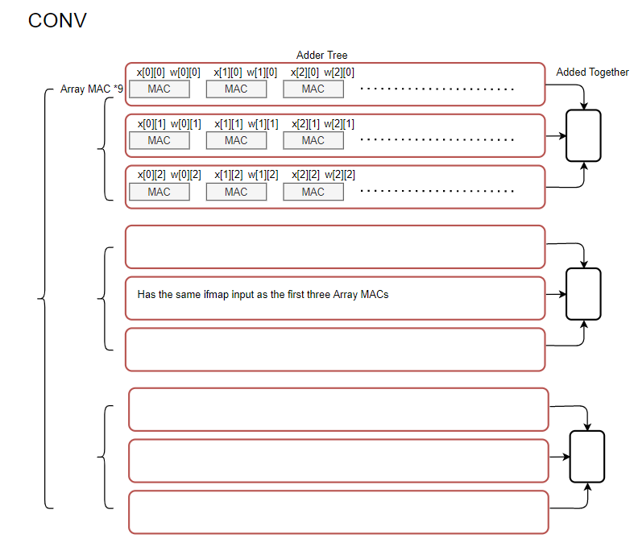
Data Flow Arrangement ---- Convolution
· Three input channels are broadcasted vertically while 3*3 windows are sent into arrays horizontally
· Every three clks write a value back to BRAM
· Kernels are sent into the array continuously, before all the output channels being derived, ifmap remains unchanged

Slide 15
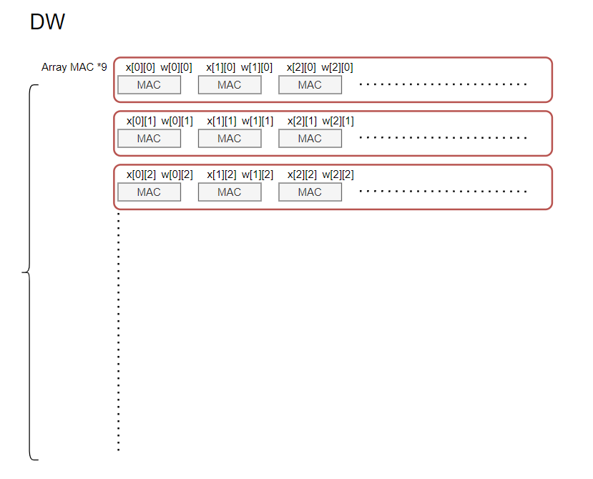
Data Flow Arrangement ---- Depthwise
· Input channels are arranged vertically while 3*3 windows are sent into arrays horizontally
· The results of each adder trees are directly concatenated together to form a output value

Slide 16
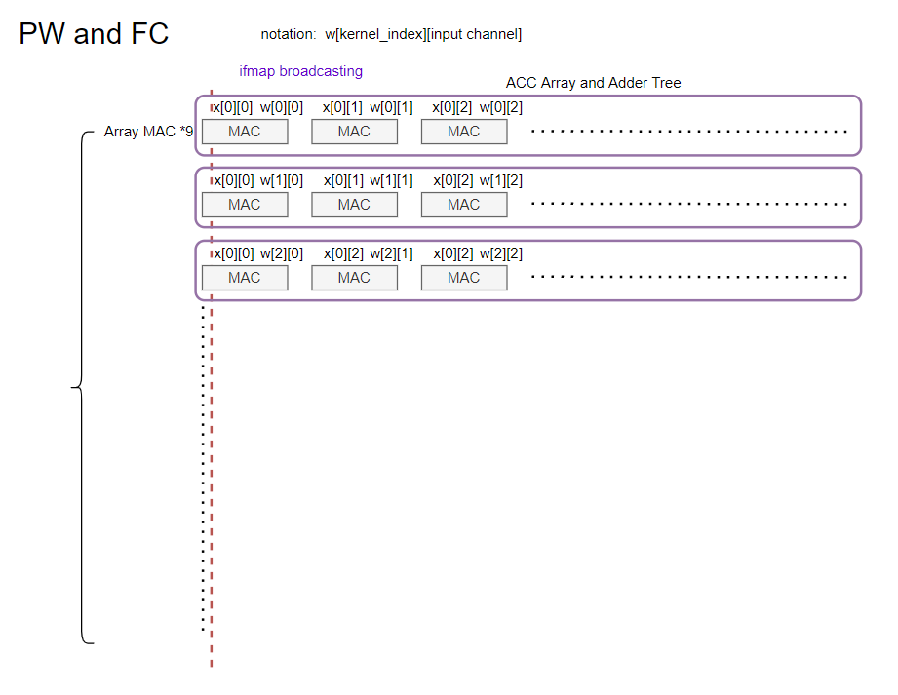
Data Flow Arrangement ---- Pointwise and FC
· Input channels are sent into the array horizontally, and then broadcast vertically
· Unlike the previous modes, this time every 9 ifmap channels are continuously sent into the array until every ifmap channels have been used in evaluation of 9 output channels.

Slide 17
Outline
Quantization Problem Solved
Problems found in Simulation
A New Structure Design
Next Phase

Slide 18
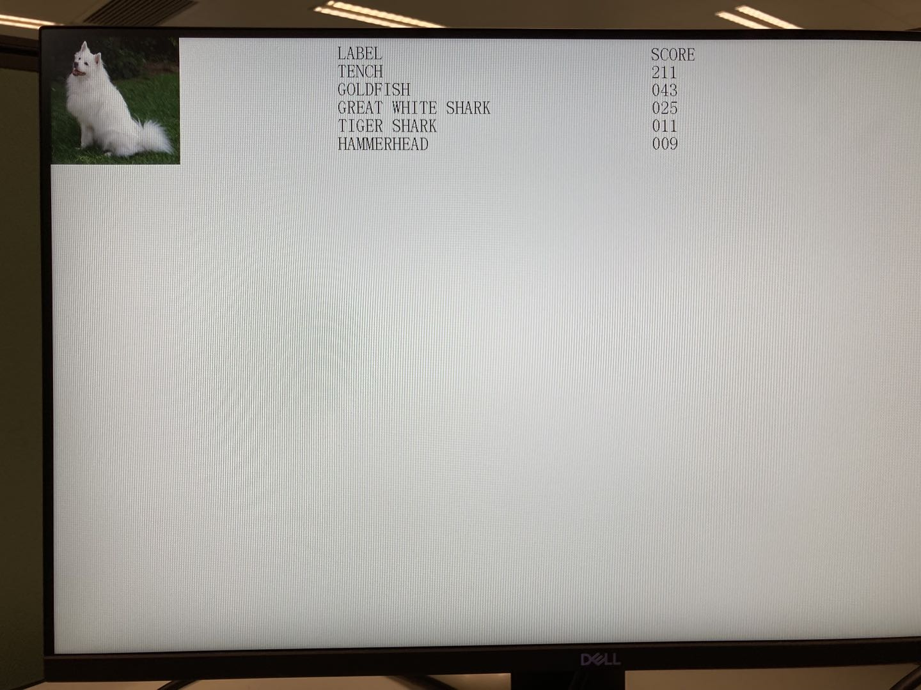
Performance
· Currently the accelerator can achieve the inference time as low as 3.9ms under simulation per image( namely 255fps ), this time can still be decreased when the Shortcut module being integrated into the dataflow and implement 200MHz system clock.
· Because of the delay of the quantization issue, we are now conducting the timing analysis before final implementation, the on-board test will be conducted this week, should be no problem.
Display on display device with resolution of 1920 × 1080

Slide 19
Project Phase
Project Phase | Deadline
Phase 1：完成神经网络的量化工作，完成系统DRAM工作模式所有相关模块的开发与仿真, 并完成板级验证 | 9月13日 9月20日
Phase 2：完成视频流的搭建工作，完成系统的全部功能开发。 | 10月8日
Phase 3：进行视频摄制 | 10月15日

Slide 20
Thank you!

